Slide 1
DOM105 2019
Session 3
Reference: SfM Ch. 5

Slide 2
Probability distribution of a discrete variable
A discrete variable is a variable that takes only discrete values. These values may not be integer, but they do not form a continuous function.
It is a mutually exclusive list of all possible numerical outcomes along with the probability of each outcome occurring.
Eg: The number of possible absentees in an office:
No. of absentees (x) | Probability
0 | 0.15
1 | 0.35
2 | 0.2
3 | 0.15
4 | 0.1
5 | 0.05

Slide 3
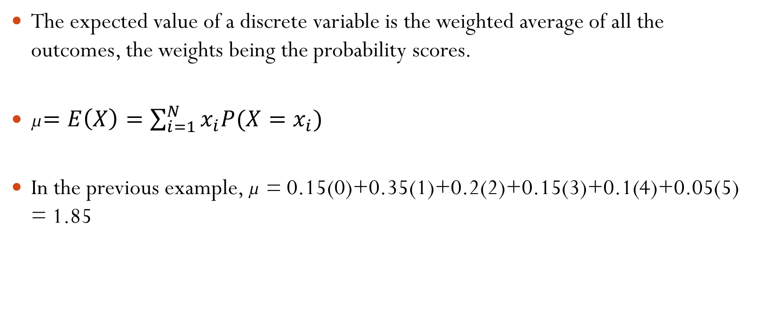
Expected value of a discrete variable
The expected value of a discrete variable is the weighted average of all the outcomes, the weights being the probability scores.
µ$=E\left(X\right)=\sum_{i=1}^{N}{x_{i}P(X=x_{i})}$
In the previous example, µ = 0.15(0)+0.35(1)+0.2(2)+0.15(3)+0.1(4)+0.05(5) = 1.85

Slide 4
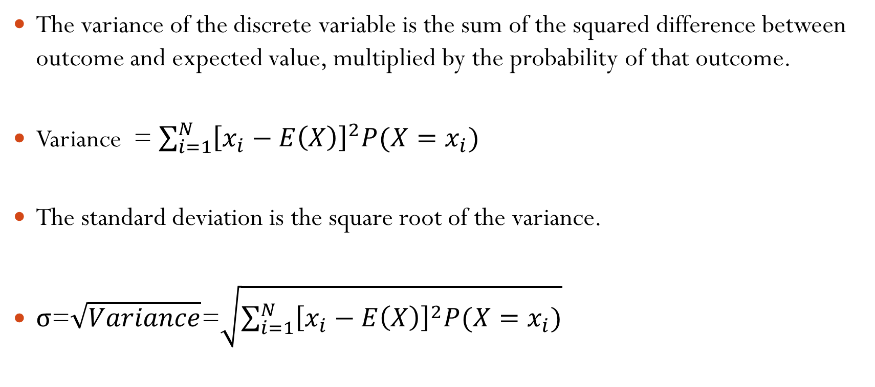
Variance and standard deviation of discrete variable
The variance of the discrete variable is the sum of the squared difference between outcome and expected value, multiplied by the probability of that outcome.
Variance = $\sum_{i=1}^{N}{{\left[x_{i}−E\left(X\right)\right]}^{2}P(X=x_{i})}$
The standard deviation is the square root of the variance.
σ=$\sqrt{Variance}$=$\sqrt{\sum_{i=1}^{N}{{\left[x_{i}−E\left(X\right)\right]}^{2}P(X=x_{i})}}$

Slide 5

The Uniform Distribution
Also called rectangular dist. Has the same chance of occurrence anywhere in its range.
P(X<=x)=(x-a)/(b-a), where b is max(x) and a is min(x)
Mean: $μ=\frac{a+b}{2}$
Variance: $σ^{2}=\frac{{(b−a)}^{2}}{12}$
Standard Deviation: $σ$

Slide 6
The Binomial Distribution
A discrete random variable distribution created by a Bernoulli Process, which has the following properties –
It is a series of trials, each trial has only two outcomes, with probabilities p and 1-p
The value of p stays fixed over the course of the process
The trials are statistically independent
If there are n trials, the chances of obtaining exactly r successes (r<=n) is given by the binomial formula (let q = 1-p):
$$\frac{n!}{r!(n−r!)}p^{r}q^{n−r}$$

Slide 7
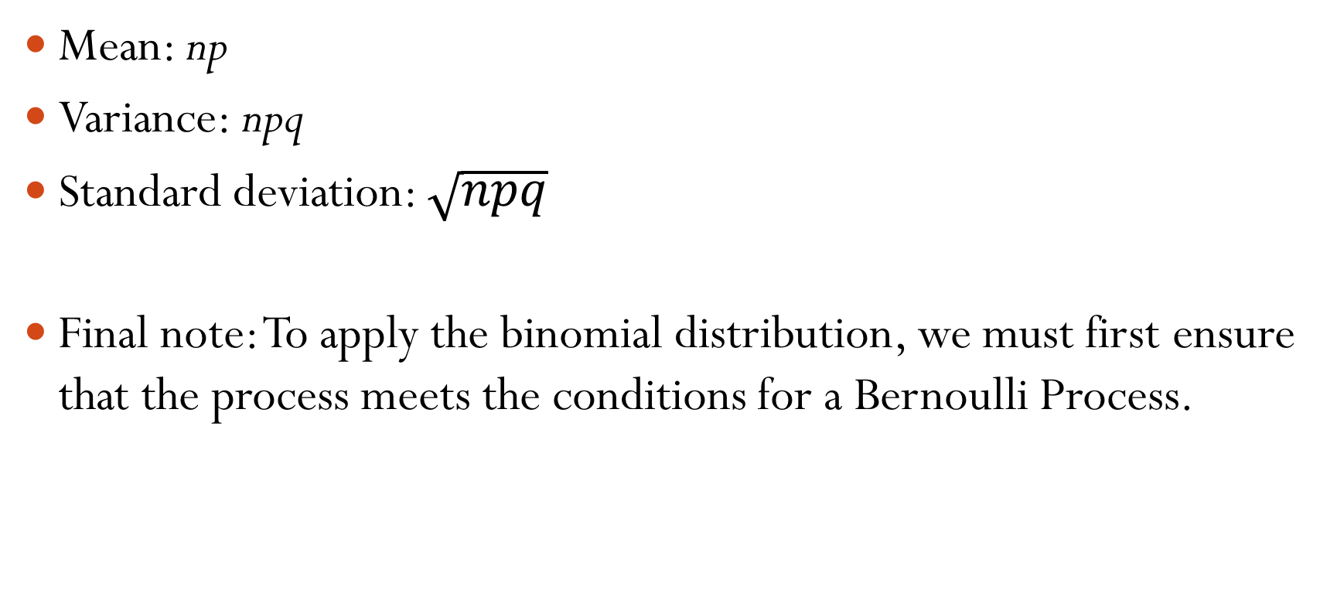
Central Tendency of the Binomial Distribution
Mean: np
Variance: npq
Standard deviation: $\sqrt{npq}$
Final note: To apply the binomial distribution, we must first ensure that the process meets the conditions for a Bernoulli Process.

Slide 8

Hypergeometric Distribution
Where the binomial distribution the sample data are selected with replacement from a finite pool (or without from an infinite pool) the hypergeometric distribution is found when the samples are taken from a finite pool without replacement.
If n samples are taken from population N, and out of the population A members are of interest, then the probability of exactly x successes out of n samples is:
$$P\left(X=x | n,N,A\right)=\frac{C_{x}^{A}C_{n−x}^{N−A}}{C_{n}^{N}}$$
Mean = $nA/N$ Std. dev. $σ=\sqrt{\frac{nA(N−A)}{N^{2}}}\sqrt{\frac{N−n}{N−1}}$

Slide 9
Out of 20 people 12 have a Masters degree. If you select 5 at random without replacement, what is the chance of 3 people having masters?
(12C3*8C2)/20C5
P of there being at least one masters?
P(x=1)+P(x=2)+…+P(x=5) = 1 - P(x=0) = 1 – (12C0*8C5)/20C5

Slide 10
Poisson Distribution
Characteristics of the Poisson Process:
The process is applied to a discrete random variable that takes integer values
The average value of the random variable over the given time period is already known or can be calculated given past data
At any one second, the possibility of a positive outcome is very small, and a fixed value.
At any one second, the possibility of two or more positive outcomes is so small we can assign it a value of zero.
The probability of a positive outcome at any given second is not only fixed, but independent of the actual time as well as the result in any other second.

Slide 11
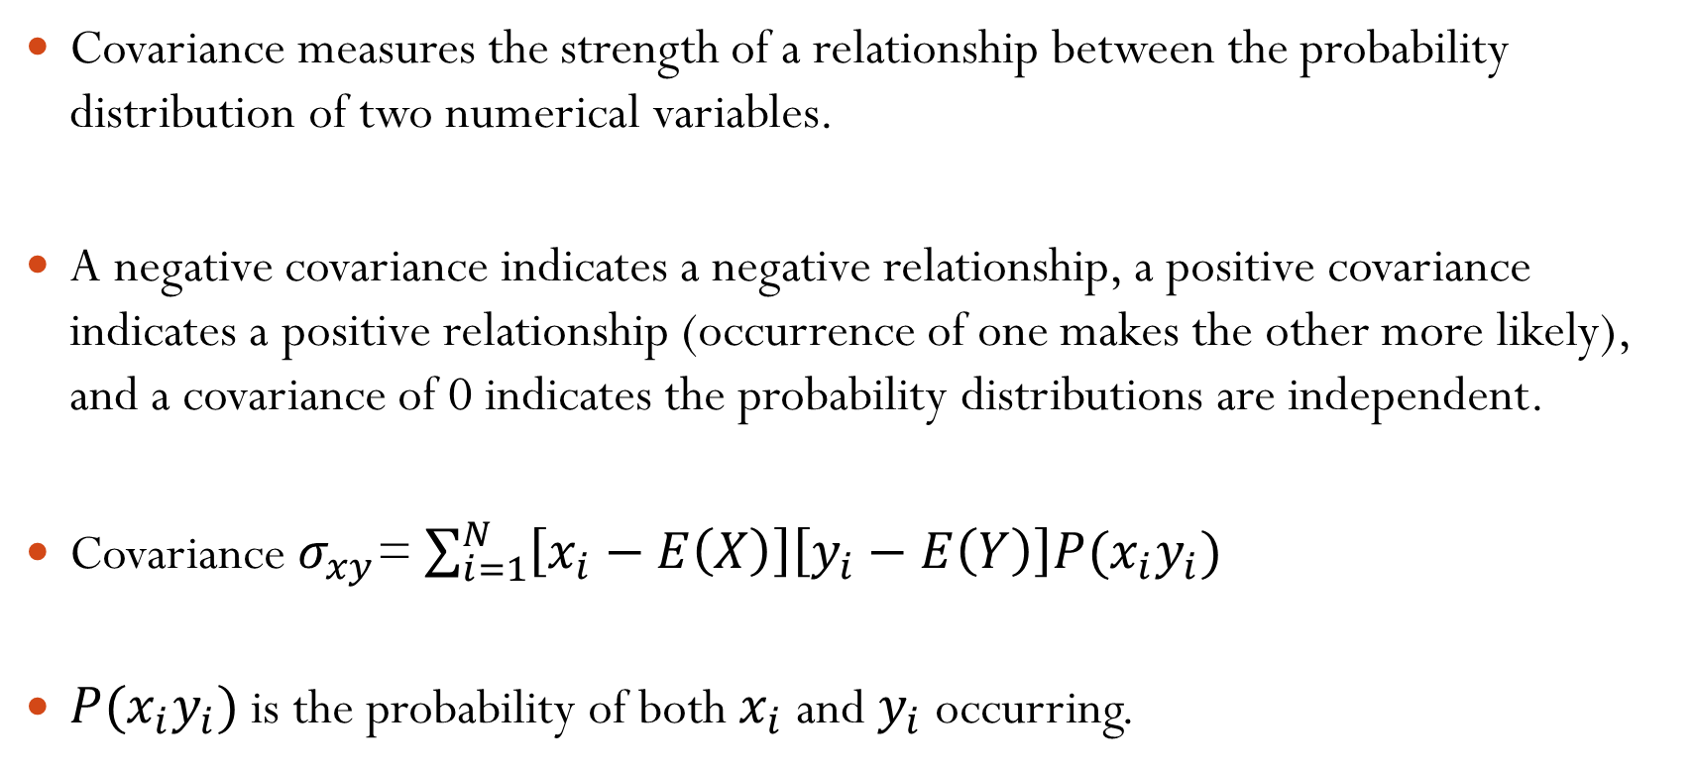
The Poisson Formula
Let λ be the mean number of occurrences in the interval of time under study.
e is the base of the natural logarithm system, approx. 2.71828
Poisson probability of x number of incidents occurring
$$P\left(x\right)=\frac{λ^{x}e^{−λ}}{x!}$$
If a binomial process has a large number of trials (n>20) and a small probability of success (p<0.05), we can use the Poisson formula after substituting the binomial mean np.
$$P\left(x\right)=\frac{{(np)}^{x}e^{−np}}{x!}$$

Slide 12
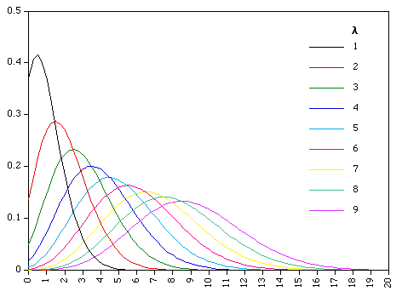

Slide 13
A store receives 5 customers an hour on average. If the hourly customer arrival follows a poisson distribution, what is the probability of receiving 10 or more customers in an hour?

Slide 14
The normal distribution
It is a continuous probability distribution. Also called Gaussian distribution.
Can be used to approximate discrete distributions, with sufficiently large samples. Can approximate Binomial distribution if np,nq>5
It is symmetrical, bell-shaped in appearance, its interquartile range is from -0.67 standard deviations to +0.67 std.devs.

Slide 15
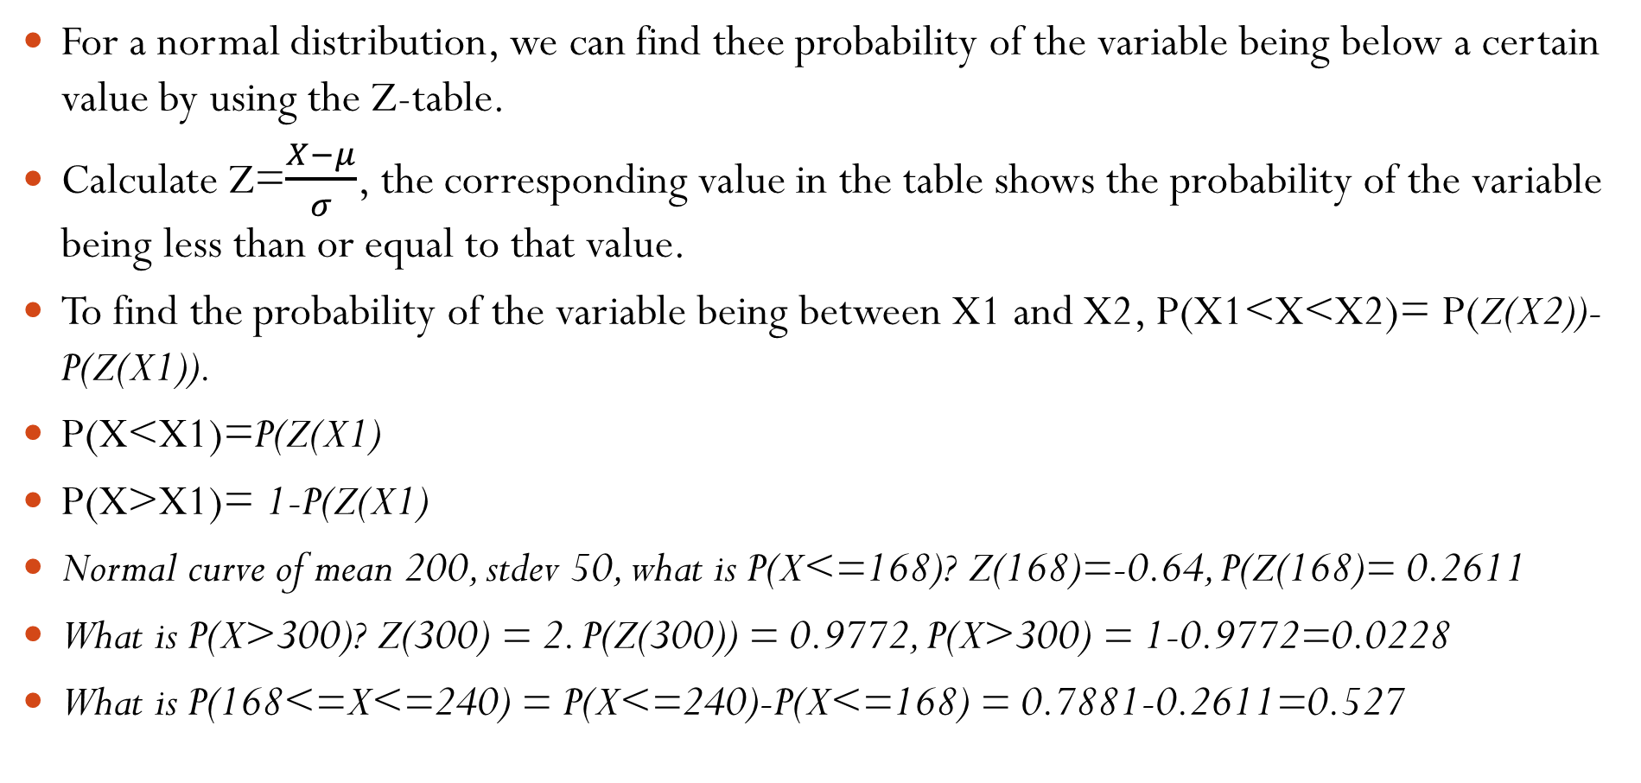
Normal Distribution from Z-score
For a normal distribution, we can find thee probability of the variable being below a certain value by using the Z-table.
Calculate Z=$\frac{X−μ}{σ}$, the corresponding value in the table shows the probability of the variable being less than or equal to that value.
To find the probability of the variable being between X1 and X2, P(X1<X<X2)= P(Z(X2))-P(Z(X1)).
P(X<X1)=P(Z(X1)
P(X>X1)= 1-P(Z(X1)
Normal curve of mean 200, stdev 50, what is P(X<=168)? Z(168)=-0.64, P(Z(168)= 0.2611
What is P(X>300)? Z(300) = 2. P(Z(300)) = 0.9772, P(X>300) = 1-0.9772=0.0228
What is P(168<=X<=240) = P(X<=240)-P(X<=168) = 0.7881-0.2611=0.527

Slide 16
The annual household income of 300 surveyed families has a mean of 16 lakhs with stdev 90,000. How many families have an income between 10 and 15 lakh?
n=300, Mean=16, Stdev = 0.90
No. of houses between 10 and 15 = n*P(10<=x<=15) = n*[P(x<=15)-P(x<=10)]
P(x<=15)=P(Z(15))=P((15-16)/0.9)=P(-1.11) = 0.1335
P(x<=10) = P(Z(10))=P((10-16)/0.9)=P(-6.67)=0
No. of houses = 300*(0.1335 – 0)=40.05 or 40 approx.
How many families do you expect to have income above 17.5 lakhs?
P(x>17.5) = 1 – P(x<=17.5)
P(x<=17.5) = P(z(17.5)) = P(1.67) = 0.9525
No. of families = 300*(1 – 0.9525) = 14.25 or 14 approx

Slide 17
Excel commands for Normal Distribution
NORM.DIST(x, Mean, stdev, 1): Returns the probability of a random variable being less than or equal to x, for a given Mean and Stdev.
NORM.INV(p, Mean, Stdev): Finds the value x for which (PX<=x)=p, for a given mean and stdev.
NORM.S.DIST(z,1): Returns the corresponding probability value for a certain Z-score (can act as substitute for Z-table)
NORM.S.INV(p): Returns the Z-score for a certain probability (can act as substitute for Z-table)

